Slide 1
2-3 trees
Edited from:
https://cs.mtsu.edu/~jhankins/files/3110/presentations/2-3Trees.ppt

Slide 2
Motivation
Binary search trees need O(n) time for search, insertion and deletion.
Would like to have a tree which self balances itself with every deletion and insertion to maintain as much a balanced tree as possible wherein all leaves are at the same level

Slide 3
Properties
Each node has either one value or two values
A node with one value is either a leaf node or has exactly two children (non-null).
Val(left subtree) < val(node) < val(right subtree)
A node with two values is either a leaf node or has exactly three children (non-null).
Val(left subtree) < val(first value in node) < val(middle subtree )< val(second value in node) < val(right subtree).
All leaf nodes are at the same level of the tree

Slide 4
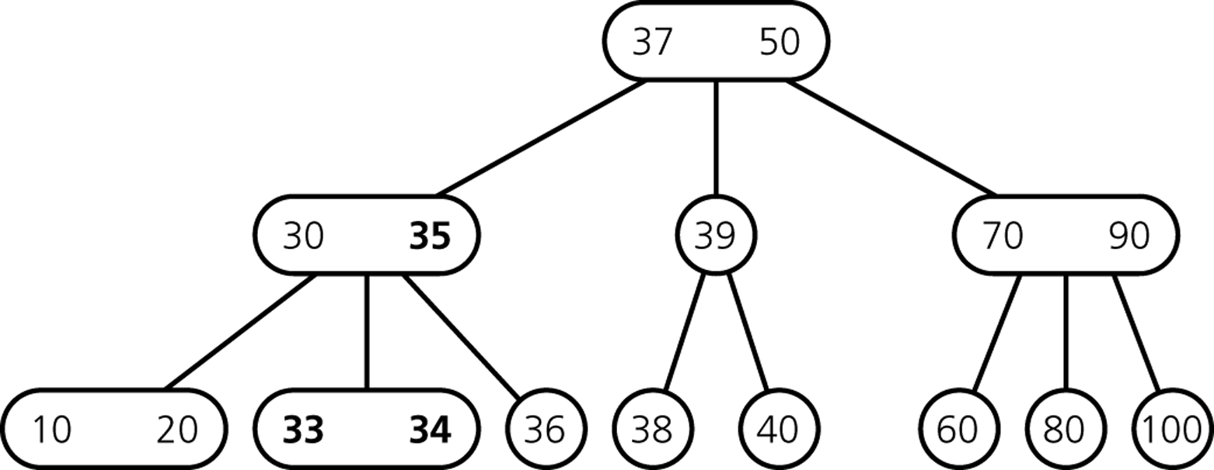
23 tree

Slide 5
Insertion

Slide 6
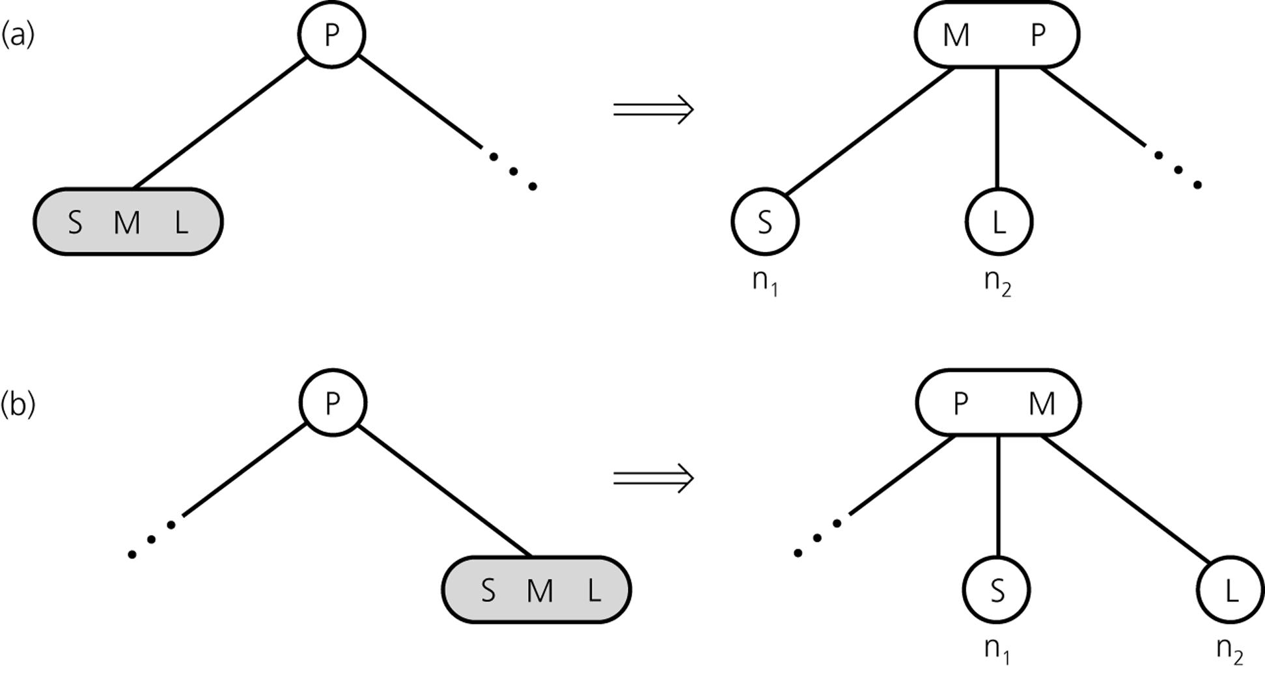
Inserting into full node

Slide 7
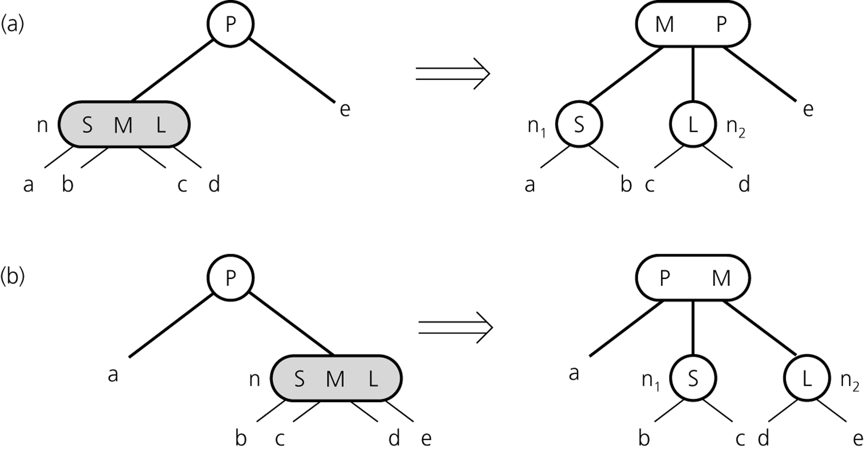
Inserting so far

Slide 8
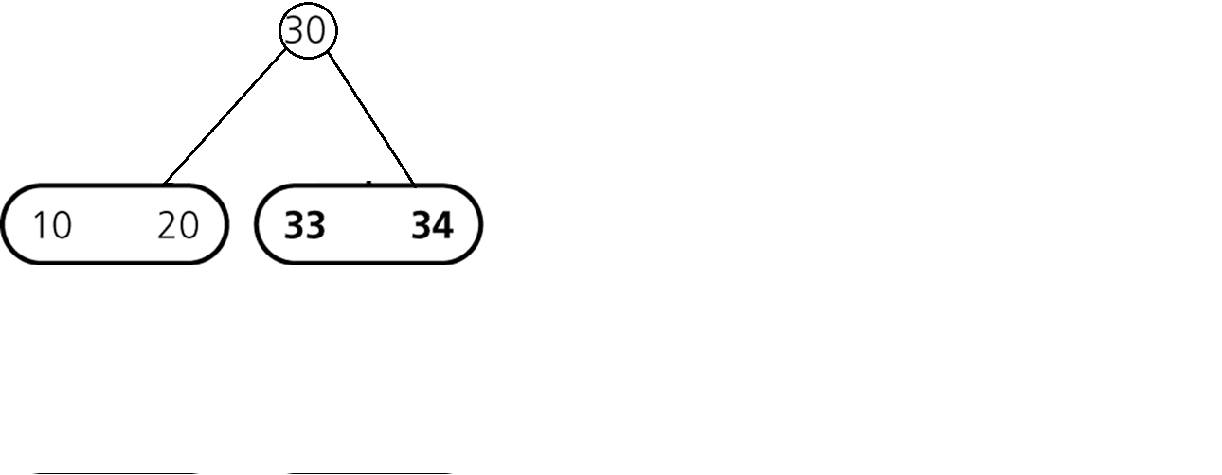
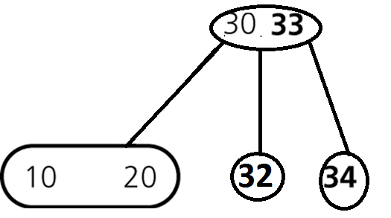
Inserting Items
How do we insert 32?

Slide 9
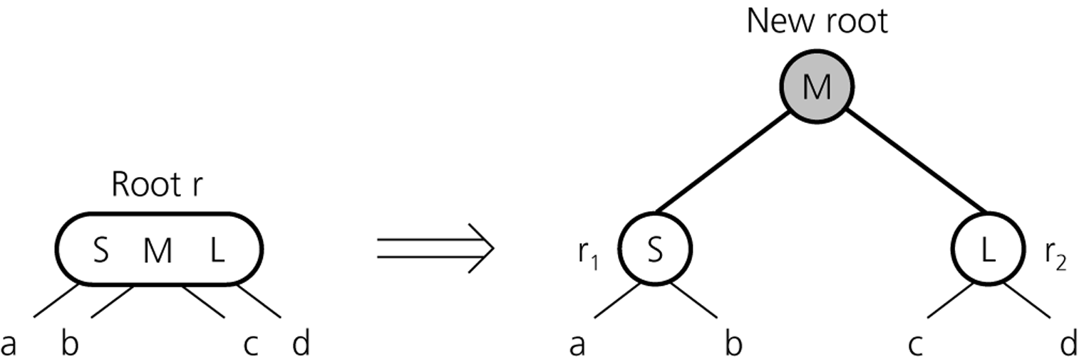
Inserting Items
creating a new root if necessary
tree grows at the root

Slide 10
Inserting Items
How do we insert 32?

Slide 11
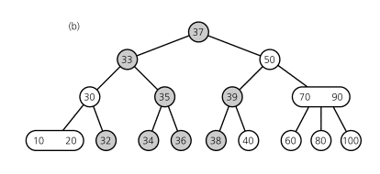
Inserting Items
Final Result

Slide 12
Insert the following
Insert into the 23 tree in the below sequence
40 30 34 50 36 80 9 37 20 100 38
70 60 39 90 33 35 95

Slide 13
Notes
The height of the 23 tree increases upwards
If a leaf can accommodate the new element then done
Else send the middle element up(iteratively until new root
formed)
When an element goes up it takes with it an new pointer
to a child increasing the number of children of the
parent node from 2 to 3(element found a place) or
from 3 to 4 (element splits current node by sending mid
element to parent node).

Slide 14
Deletion

Slide 15
Step 1
Deletion happens at the leaf node.
If the node to be deleted is not on a leaf node:
swap it with the closest successor.
The node to be deleted is now in a leaf node !!
If tree on deletion is not 23 then you either redistribute
or merge.
-Redistribution: When an empty node has a two item
sibbling(recreates a 23 tree)
-Merging: When an empty node has a sibbling with
single item(might need multiple iterations that propogates
upwards until a 23 tree is restored)

Slide 16
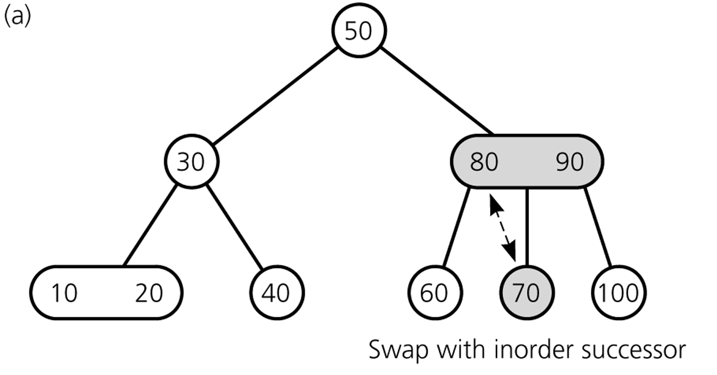
Case 1: two keys
If the leaf has two keys
Delete 20
70
80

Slide 17
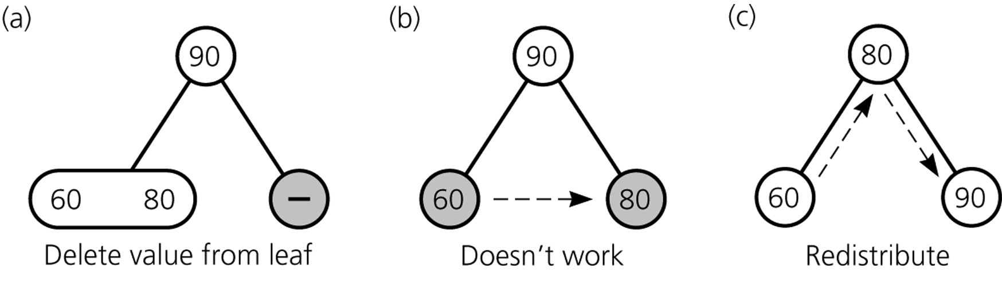
Case 2: Redistribution
If item to be deleted is a single key and sibbling has two keys

Slide 18
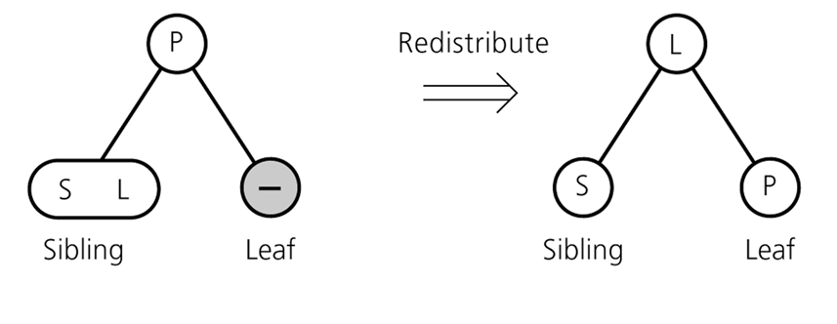
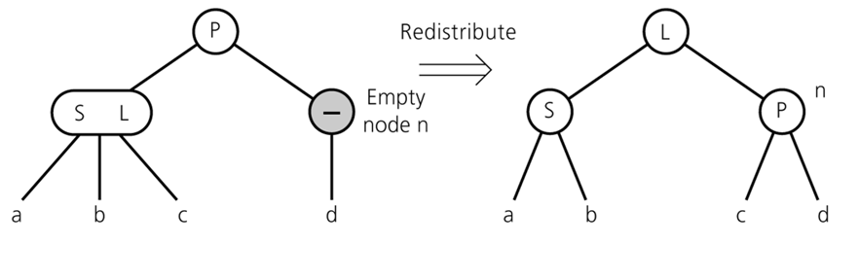
Redistribution
A sibling has 2 items:
redistribute item
between siblings
and parent

Slide 19
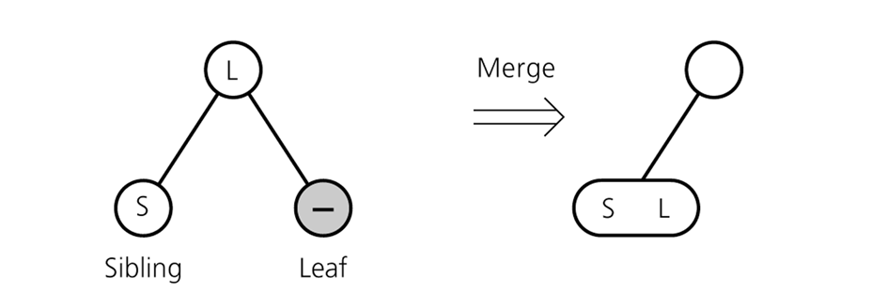
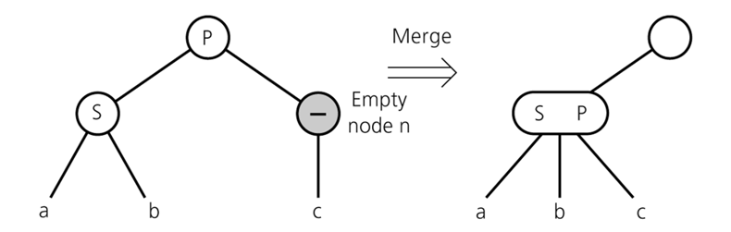
Case 3: Merging
When single key node
to be deleted and sibbling
Has single key
move item from parent
to sibling
adopt child of n
If n's parent ends up without item, apply process recursively

Slide 20
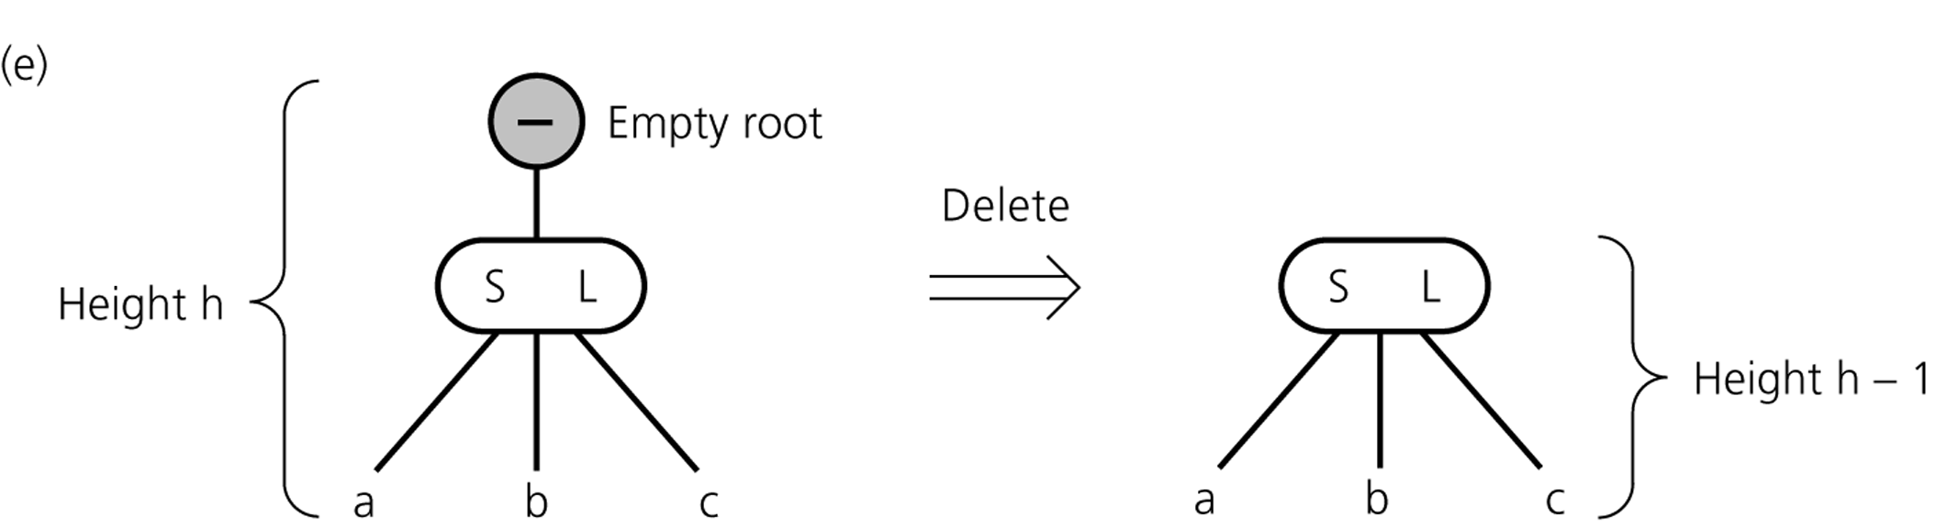
Merging till root
If merging process reaches the root and root is without item
→ delete root

Slide 21
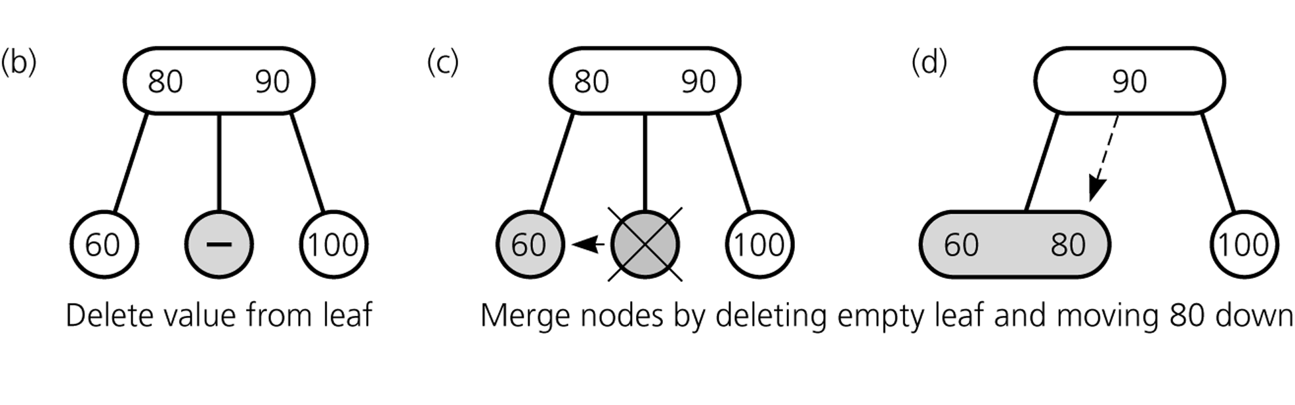
Merge with: double key node

Slide 22
Try
50
30,45
10,20 40 47 60,90
45
30 50
10,20 40 47 60,90

Slide 23
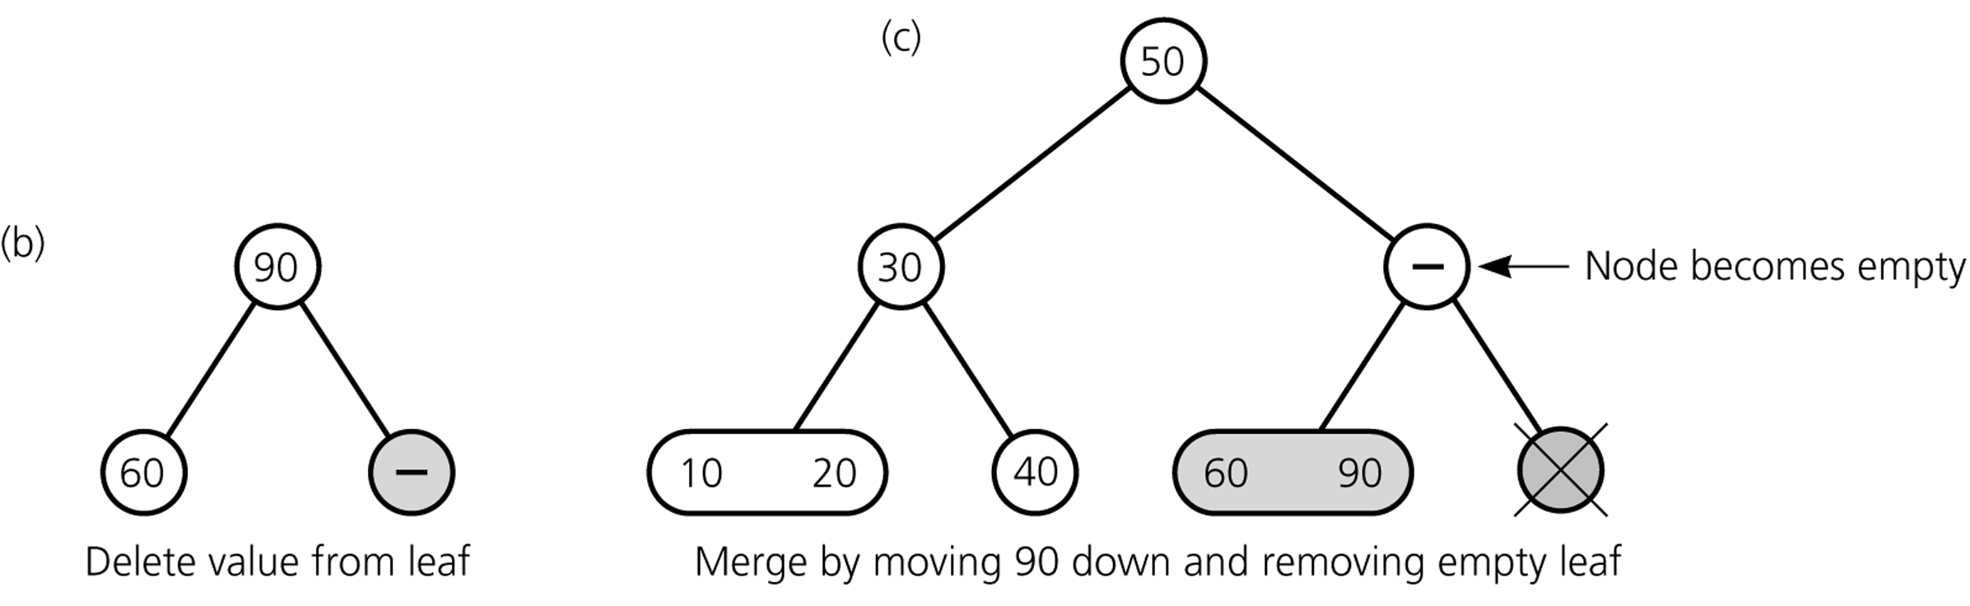
Merge with single key sibbling -1

Slide 24
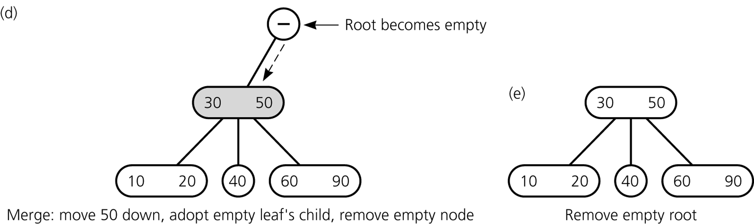
Example: Merge with single key sibbling -continued

Slide 25
Delete the following
After having Inserted the below
30 34 50 36 80 9 37 20 100 38
70 60 39 90 33 35 95
Delete 36, 40,60, 70,80,9 ,30

Slide 26
Conclusion
23 tree is a balanced binary tree satisfying three properties
-leaf nodes at same level
-every 2 node must have three children
-every 1 node must have two children
Insertion: Always at leaf. If no space push middle element
up which might propagate till root increasing tree height.
Deletion: Starts at leaf. Three methods
-simple delete: removes one out of two elements in leaf node
- redistribution
- merging: but might propogate upwards till root. Can reduce
tree height by 1.

